Slide 1
Installing SharePoint Server 2010
Notes:
This module explores the various topologies that can be used to build a SharePoint 2010 farm and introduces the new Service Application architecture of SharePoint Foundation. Students will learn how to choose between common deployment topologies when installing SharePoint Server 2010 in a variety of scenarios. The module also discusses best practice techniques for creating dedicated service accounts in Active Directory to provide the identity for various worker processes in a SharePoint 2010 farm.

Slide 2
Agenda
Understanding Farm Topologies
Installing Perquisite Software
Creating Dedicated Service Accounts
Installing SharePoint Server 2010
Creating the Farm and Configuration Database

Slide 3
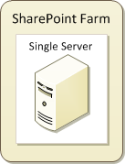
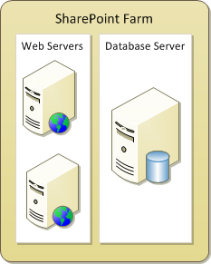
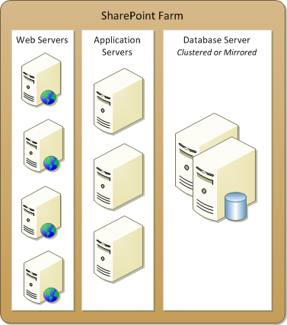
Topologies
SharePoint designed to scale from small to large
farm can be single-server deployment (easiest)
farm can run Web server(s) and database server
farm can offload processing to application server(s)
Topology 1
Topology 2
Topology 3
Notes:
A SharePoint farm can be single server or multi-server. Each SharePoint farm has only one configuration database.
Single-server farm
Installing SharePoint on a single server, is called a standalone installation. As a general rule, you can use a standalone installation of Windows SharePoint Services 3.0 to support up to 10,000 users, depending on your hardware configuration and the behavior patterns of your users.
A standalone installation can be appropriate if you want to evaluate SharePoint Products and Technologies or if you require a small, non-business critical deployment where high availability is not essential.
Small server farm
A small server farm deployment consists of a single combined front-end Web and application server and a single database server. The advantages over a single-server deployment are:
Contention for memory, processor time and disk access by the front-end Web and application server and the database server role is reduced.
Provide an additional layer of protection for your data by installing the front-end web server(s) in your perimeter network and the database server behind the second firewall in your internal network.
The disadvantage of this deployment model is that it does not provide any server-tier redundancy in case of hardware failures.
Medium server farm
A typical medium server farm may include: Two network load-balanced front-end Web servers; A dedicated application server; Two clustered or mirrored database servers.
To provide high availability for the database tier, you can also add a clustered or mirrored database server. At this stage, this is likely to be an availability consideration rather than a capacity consideration.
Large server farm
You can extend your server farm by adding a dedicated application server for search and index service, which should result in better performance. Additional servers can be added to which other application server roles can be allocated.

Slide 4
Web Front End Servers
Web Front End (WFE)
Provides the web interfaces for the users
Very little disk storage used
Microsoft recommendation for determining scale
10,000 users per WFE as a starting point
Example: If you are planning to support 20,000 users then build farm with two Web Servers
Notes:
The Web Front Ends provide the web interfaces for the users. They use very little disk storage as they only store the files and settings required to route requests from clients to the appropriate sites in the database.
All site content and all configuration data is shared for all front-end Web servers in a server farm. To get the best performance and the best protection against hardware failure, you should configure Windows SharePoint
Services identically on all the front-end Web servers in your server farm.
Most changes to configuration settings in Windows SharePoint Services are replicated automatically. For example, when you change the e-mail server for SharePoint, you do this from within the SharePoint Central Administration or by using WindowsPowerShell. You make this change only once, the change is entered in the configuration database, and automatically applied to all servers in the server farm.

Slide 5
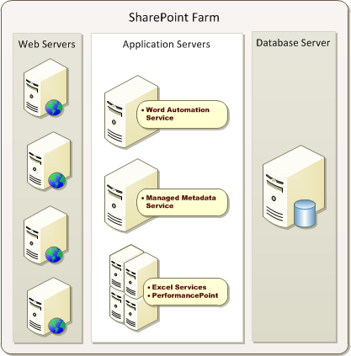
Application Servers
Application server associated with app service(s)
app services can be deployed on app server
each app service can reside on dedicated app server
not all app services support app server deployment
group similar app services on same app server
Notes:
The SharePoint application services can be deployed to one or more dedicated application servers.
You can also consider to move the Indexer role to a separate application server. The server with the index server role crawls and indexes content sources. If the SharePoint farm is heavily queried, you can also consider to move the Query role to a separate server.
Additionally the SharePoint 2010 Application Services that can be installed on separate application servers are:
Managed Metadata Service
Excel Services
PerformancePoint
Word Automation Service

Slide 6
Choosing a Topology
Let's examine some commonly-used topologies
Single Server Farms
Two Server Farms
Two Tier Small Farms
Three Tier Small Farms
Three Tier Small Farms with Search Optimization
Medium Farms
Large Farms with Server Groups
Notes:
And now we will examine each of these topologies in more detail.

Slide 7
Single Server Farms
All roles on one server including SQL Server
Useful for evaluation, testing and development
Not scalable to most production environments
Scales to about 100 users
Notes:
In a single-server installation, all software components including SQL Server are installed on the same server.
The standalone approach limits the manageability and scalability of your solution, especially when SQL Server Express is used to store the databases. Installing SQL Server Standard or Enterprise edition makes the solution more scalable: you can move the databases to a separate database server in a later phase.
This configuration can be sufficient for evaluation or testing purposes but absolutely not recommended for production environments. Also keep in mind that it is painful to start with a single-server farm and reconfigure it to be a multi-server farm. Be wary of the proof-of-concept farm that becomes a production farm. Any production farm should begin it's life as a farm where the web server running SharePoint 2010 is a different machine than the machine running the configuration database.

Slide 8
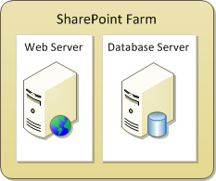
Two Server Farms
All Web and Application Roles on one Server
SQL Server run on a dedicated database server
Support up to 10,000 users
For 1,000 users or more, mirrored or clustered database servers recommended
Notes:
A small server farm deployment consists of a single combined front-end Web and application server and a single database server. This offers several advantages over the standalone or single-server deployment model. Contention for memory, processor time, and disk access by the front-end Web and application server and the database server role is reduced, so your throughput rate will increase accordingly. You can also use this approach to provide an additional layer of protection for your data, by installing the front-end Web server in your perimeter network and the database server behind the second firewall in your internal network.
The disadvantage of this deployment model is that it does not provide any server-tier redundancy in case of hardware failures. For instance, if either the front-end Web and application server or database server fails, the entire farm will fail.
To provide high availability for the database tier, you can also add a clustered or mirrored database server. At this stage, this is likely to be an availability consideration rather than a capacity consideration.

Slide 9
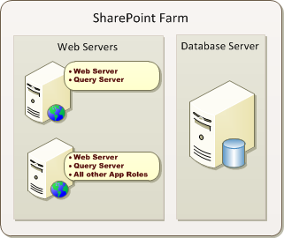
Two Tier Small Farms
Two Web servers handle all Web and App Roles
Can scale to about 10,000-20,000 users
Notes:
When you scale up from a small server farm, your first step will usually be to add either a dedicated search server, or a dedicated search server and an additional second front-end Web server. By adding the dedicated search server, you should see better performance but will continue to be vulnerable to a failure at the front-end Web tier, which is why you should also add the additional front-end Web server to the farm. You should configure network or hardware load-balancing to distribute incoming HTTP requests between the two servers. This helps to maximize the increase in capacity that you gain from the second server. It also provides high availability for the front-end Web tier in the event that one of the front-end Web servers fails.
Note that configuring a Web Front End server to be a query server is going to increase the storage requirements. This is due to the fact that the index files for search must reside on the Web server.

Slide 10
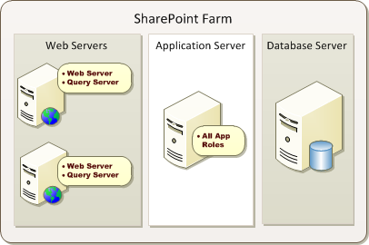
Three Tier Small Farms
Add dedicated application server
Used for environments with moderate service usage
Notes:
How you distribute server roles between servers should depend on how people use your SharePoint farm, and you can only determine the optimal distribution of server roles through careful performance monitoring. In a small three-tier farm, all application roles are installed on the application server. You can scale out by adding more application servers and distribute the service applications over the different application servers.

Slide 11
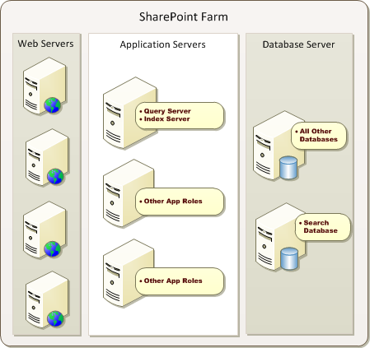
Medium Farms
Servers added as needs to accommodate scale
Add more Web servers as needed
Add more application servers as needed
Add more database servers as needed
Notes:
You can further scale up your farm by adding
web servers to manage an increase in user load
distributing service application roles over additional application servers,
database servers to manage an increase in data load
Microsoft recommends that you add a database server for content databases for every four front-end Web servers.

Slide 12
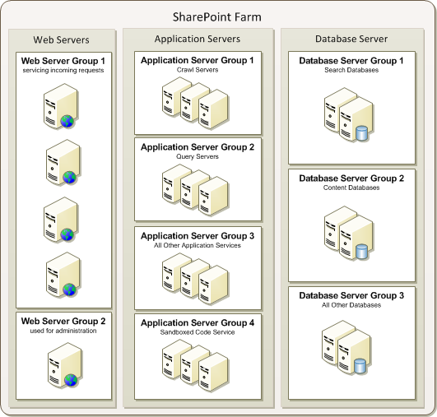
Large Farms with Server Groups
Servers on any of the 3 tiers can be grouped
Group together services and database with similar performance characteristics
Notes:
You can also group servers together, based on functionality and performance characteristics.

Slide 13
Agenda
Understanding Farm Topologies
Installing Perquisite Software
Creating Dedicated Service Accounts
Installing SharePoint Server 2010
Creating the Farm and Configuration Database

Slide 14
Server Hardware Requirements
From Microsoft: (Single Server Minimums)
2.5 GHZ, 8 GB RAM (Production)
80 GB HDD
Other notes:
Gigabit network between servers in farm
64-bit everything!
TechNet: SP2010 HW/SW Requirements
http://bit.ly/QzdQC
Notes:
Hardware requirements for the Web servers and application servers
Processor:
64 bit
4 cores
RAM:
4 GB for developers and evaluation purposes
8 GB for production environments
Hard disk
80 GB
Hardware requirements for the database servers:
Processor:
64 bit
4 cores for small deployments, 8 cores for larger deployments
RAM:
8GB RAM for small deployments, 16GB for larger deployments
Hard Disk:
80GB hard drive

Slide 15
Operating System Requirements
Operating system required for SharePoint 2010
64-bit version of Windows Server 2008 R2 (recommended)
64-bit version of Windows Server 2008 SP2 or later
For a development or testing environment
64-bit version of Windows 7 or Windows Vista
Notes:
For production environments you should install SharePoint 2010 on the 64-bit version of Windows Server 2008 or Windows Server 2008 R2. If you install on Windows Server 2008, you should have at least SP2 installed.
You can install SharePoint 2010 on 64 bit version of Windows 7 or Vista but use it only for development or testing purposes. Use Windows 7 to simulate a production environment running Windos Server 2008 R2. Use Vista with all the latest service packs installed to simulate a production environment running Windows Server 2008

Slide 16
Active Directory Requirements
Create SharePoint farms within AD domains
Use AD domain accounts as service accounts
Do not rely on local accounts from servers
All farm servers should be added to same domain
They need to see the same set of accounts
Notes:
Before installing SharePoint 2010, Active Directory Domain services should be installed on a server within the farm.
The necessary accounts for installing and configuring SharePoint 2010 and its application services should be created within the domain. Never use the local administor account for installing SharePoint.
SharePoint farms should be installed within the Active Directory domain.

Slide 17
SQL Server Requirements
SQL Server must be 64-bit version
Select a version of SQL Server
SQL Server 2008 R2 (recommended)
SQL Server 2005 SP3 + KB967909
SQL Server 2008 SP1 + KB970315
Notes:
Before you can install SharePoint 2010, you should have installed SQL Server.
The SQL Server software must be the 64-bit version, but there are a number of versions that are allowed. Although SQL Server 2008 R2 is recommended, you can also install SQL Server 2008 with at least SP1 and CU2, or even SQL Server 2005 with at least SP2.

Slide 18
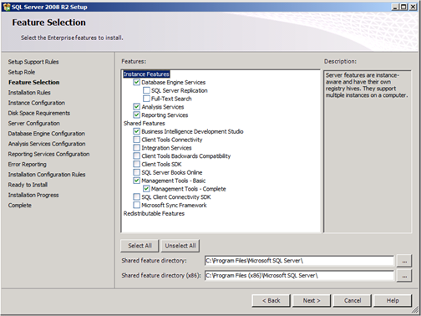
SQL Server Components
Required
Database Engine
Optional components with SharePoint integration
Analysis Services
Reporting Services
Caveat:
SQL Server Reporting Services must be installed on Web Server computer
Notes:
When installing SQL Server, you should install at least the Database engine.
Optionally you could install SQL Server Analysis Services (SSAS) and/or SQL Server Reporting Services (SSRS).
Installing SQL Server Analysis Services (SSAS) provides the ability to create and run business intelligence (BI) objects such as cubes and key performance indicators. These BI objects can be consumed and leveraged using service applications in SharePoint Server 2010 such as Excel Services and PerformancePoint Services.
Installing SQL Server Reporting Services (SSRS) provides the ability to intergate SSRS reports to run inside SharePoint. Note that SSRS must be installed on the front end Web Server. This means you will often install the SQL Server DB engine and SSAS on the computer that plays the role of the database server but then you will install SSRS on a computer playong the role of the Web server.
Installing Business Intelligence Development Studio (BIDS)makes it possible to create and deploy business intelligence objects such as data warehouse cubes and key performnce indicators (KPIs) into a SSAS database. Therefore, it makes sense to install BIDS if you need to configure some of the SharePoint Server 2010 application services focusing on business inteligence such as PerformancePoint Services and Excel Services. It can also help to configure and test the intragation of SSRS into a SharePoint 2010 farm.

Slide 19
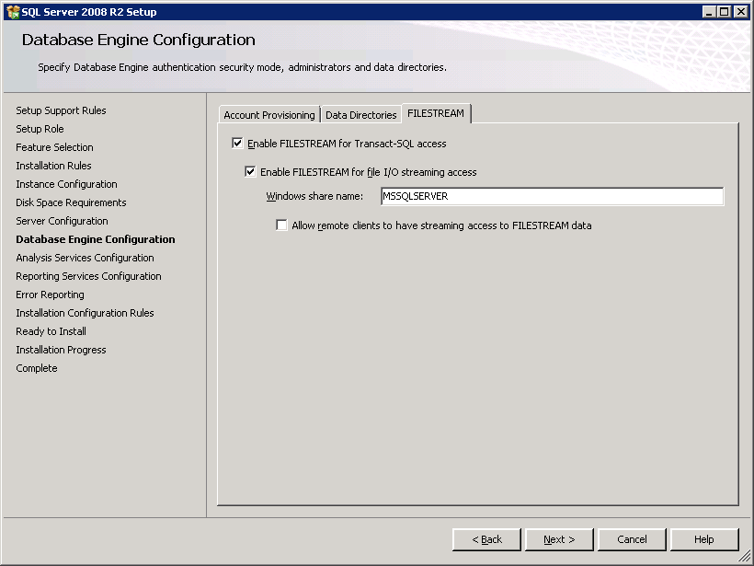
Optional Step: Enable File Stream
Option required if using Microsoft RBS provider
Not required if not using Microsoft RBS provider
You can also enable FILESTREAM after installation
Notes:
RBS is a library API set that is incorporated as an add-on feature pack for Microsoft SQL Server 2008 and Microsoft SQL Server 2008 Express. RBS is designed to move the storage of binary large objects (BLOBs) from database servers to commodity storage solutions. RBS ships with the RBS FILESTREAM provider, which uses the RBS APIs to store BLOBs.
In SharePoint Server 2010, site collection backup and restore and site import or export will download the file contents and upload them back to the server regardless of which RBS provider is being used. However, the FILESTREAM provider is the only provider that is currently supported for SharePoint 2010 Products farm database backup and restore operations.

Slide 20
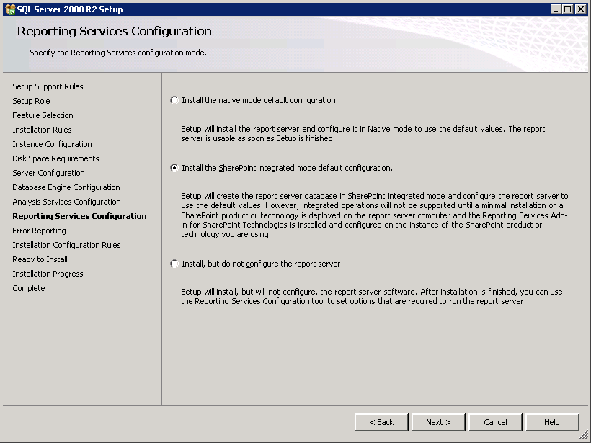
Installing SQL Server Reporting Services
Options for installing SSRS
Install the SharePoint integrated mode default configuration Good option when installing on test farms and development farms
Install, but do not configure the report server Recommended option when installing on multi-server productions farms
Notes:
If you want to integrate SQL Server Reporting Services with SharePoint, you should set the SharePoint Integrated Mode option.
When created for SharePoint integrated mode, the report server database stores server properties, report execution snapshots, report history, subscription definitions, and schedules. It stores a secondary copy of reports, report models, shared data sources, and resources to improve processing performance on the server. Primary storage for report documents is in the SharePoint content databases.

Slide 21
Agenda
Understanding Farm Topologies
Installing Perquisite Software
Creating Dedicated Service Accounts
Installing SharePoint Server 2010
Creating the Farm and Configuration Database

Slide 22
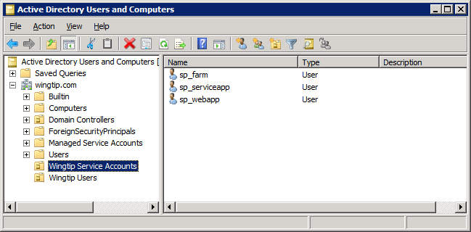
Creating SharePoint Service Accounts
You should create dedicated service accounts
Optionally, create an Organizational Unit (OU) in Active Directory to isolate dedicated service accounts
Notes:
Windows Server 2008 R2 automatically creates Managed Service Accounts Organizational Unit. It provides valuable built-in behavior for managing service accounts. While, this new Windows Server feature is not covered in this training class, it can be valuable if you learn how to properly use it. It should also be stressed that you should not use the Managed Service Accounts Organizational Unit unless you completely understand how it works.

Slide 23
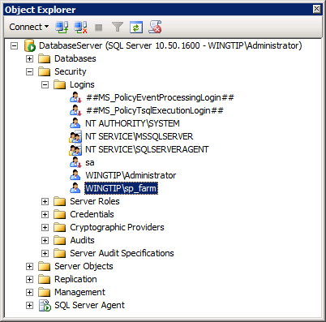
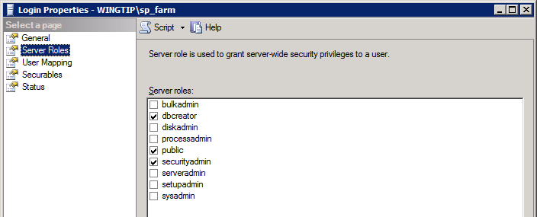
Domain Accounts Required for Install
Install User Account (e.g. WINGTIP\Administrator)
Member of Local Administrators group on each server
SQL Server login in roles of dbcreator and securityadmin
You must configure SQL security settings for install account
Server Farm Account (e.g. WINGTIP\sp_farm)
SQL Server login in roles of dbcreator and securityadmin
Account becomes database owner for all SharePoint databases
SharePoint automatically configures SQL security settings for farm account
Notes:
The install account must be member of the local Administrators group. This is the account you are logged in as when you install SharePoint 2010.
You provide SharePoint with the name and password of the Server Farm account when you create a new farm. When you install SharePoint 2010, it automatically creates a SQL Login for the farm account and adds it into the SQL Server roles of dbcreator and securityadmin. Note that the farm account is used to create the configuration database and content database. Therefore, the farm account becomes the database owner of all the SQL Server databases created by SharePoint 2010.
Steps to follow prior to the installation of SharePoint 2010:
Create the necessary accounts in Active Directory.
From SQL Management Studio add a new SQL Login for the install account (WINGTIP\Administrator).
Configure install account to be in SQL Login Server roles of dbcreator and securityadmin
In the lab, you will use the WINGTIP\Administrator account as the install account. Note that with the two VMs you are using this week that SQL Server was installed using WINGTIP\Administrator. That means the WINGTIP\Administrator is already in the role of the SQL Server system administrator and already has all the required permissions in SQL Server. This means there is no requirement for configuring SQL Server security before you install SharePoint Server. However, you should be prepared to follow these steps when installing SharePoint 2010 in an environment where the SharePoint farm account has not already been configured to be the SQL Server system administrator.

Slide 24
Agenda
Understanding Farm Topologies
Installing Perquisite Software
Creating Dedicated Service Accounts
Installing SharePoint Server 2010
Creating the Farm and Configuration Database

Slide 25
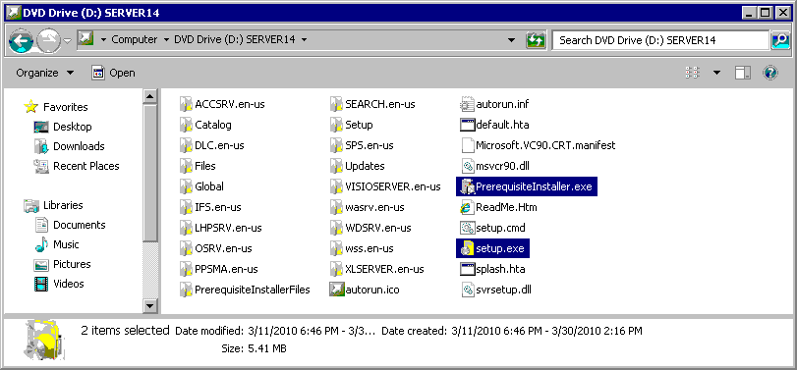
SharePoint Server Install Files
SharePoint Server 2010 installation files
Extract from SharePointServer.exe if required
C:\Install\SharePointServer.exe /extract:C:\Install\SharePoint2010
Locate the two main EXEs for installation
PrerequisiteInstaller.exe
Setup.exe
Notes:
The SharePoint Server 2010 installation files are compressed in a .exe file. You can extract them by double-clicking the exe, or by executing a command which gives you control over where you extract the files.
There are 2 files that need to be executed for installing SharePoint 2010:
PrerequisiteInstaller.exe
Setup.exe

Slide 26
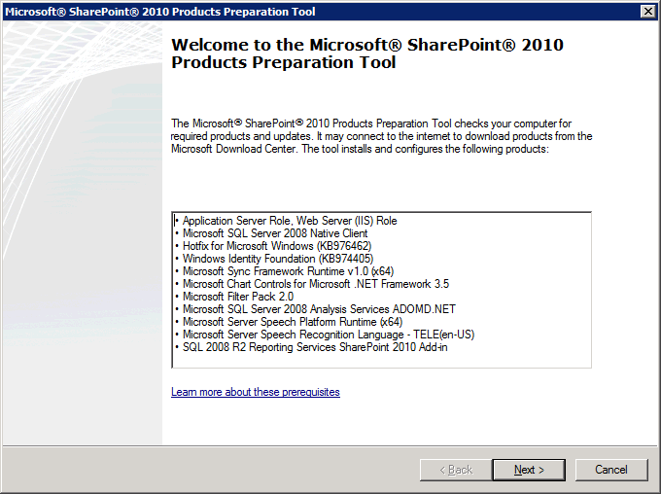
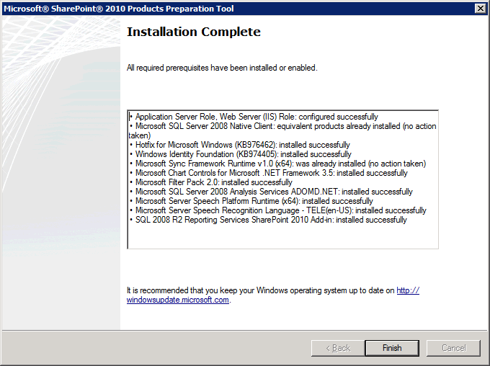
Running PrerequisiteInstaller.exe
PrerequisiteInstaller.exe does the following
Configures IIS settings on Windows Server 2008 (R2)
Adds other important utilities
Notes:
Notes about running PrerequisiteInstaller.exe
The PrerequisiteInstaller installs all prerequisite software prior to installing SharePoint 2010. You can find more about the prerequisite software here: http://technet.microsoft.com/en-us/library/cc262485.aspx#section5
The server should be connected to the Internet when running PrerequisiteInstaller.exe, because it download the required software prior to installing it.
Reboot the server machine after running PrerequisiteInstaller.exe (even though you are not prompted to do so)
PrerequisiteInstaller.exe does not work on Windows 7 so prerequisites must be installed by hand.

Slide 27
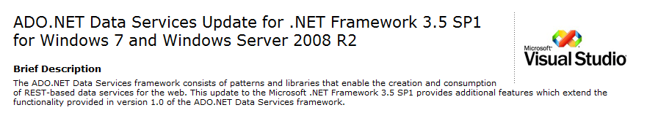
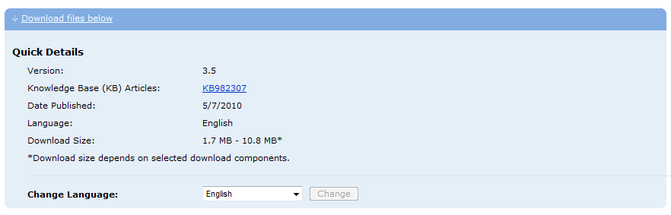
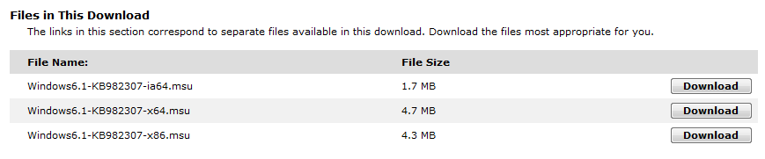
Installing WCF Data Services
ADO.NET Data Services must be installed by hand
Not installed automatically due to bug in PrerequisiteInstaller.exe
Required to make LIST.svc and REST-based Web Services work properly
http://www.microsoft.com/downloads/details.aspx? FamilyID=3e102d74-37bf-4c1e-9da6-5175644fe22d
Notes:
Download from
http://www.microsoft.com/downloads/details.aspx?FamilyID=3e102d74-37bf-4c1e-9da6-5175644fe22d
Or type the shorter URL of http://bit.ly/9R2ju8
Note that Microsoft is currently in the process of changing the name ADO.NET Data Services over to WCF Data Services. It is likely that future updates to this Web service component will be posted under the new name of WCF Data Services.

Slide 28
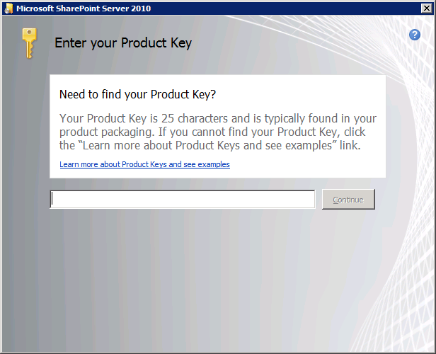
Running Setup.exe
Setup.exe begin the installation process
You will be prompted for product key
Choose product key for appropriate version
SharePoint Server 2010 Enterprise Client Access License features
SharePoint Server 2010 Standard Client Access License features
SharePoint Server 2010 for Internet Sites, Enterprise
SharePoint Server 2010 for Internet Sites, Standard
Notes:
After installing the prerequisites and rebooting the server, you are ready to run the setup.exe to start the installation of SharePoint 2010.
Beware of requesting the product key for the appropriate version.

Slide 29
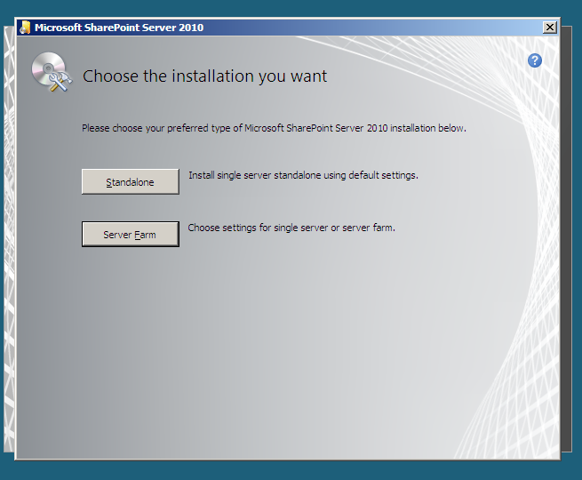
Never Choose Standalone Installation
This results in several undesirable outcomes
It installs and uses local SQL Server Express
It uses local accounts instead of domain accounts
Notes:
Don’t choose to install as a Standalone installation because that installs SharePoint 2010 using local accounts. It also uses SQL Server Express instead of SQL Server.
If you know PowerShell well enough, there are ways to overcome these limitations, especially the one of SQL Server, but they are not at all recommended.

Slide 30
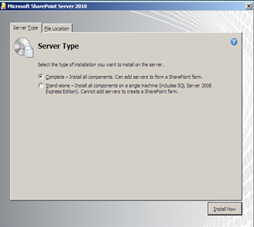
Server Type
Complete used in vast majority of scenarios
Installs all components
Gives you maximum configuration flexibility
Stand-alone should not be used
Same result as choosing standalone from previous screen
Notes:
When choosing for the Farm Install, you can choose between Complete and Standalone. It is recommended to choose the Complete install because it installs all components.
Note that it is possible to install just Web server components using Windows PowerShell scripting.

Slide 31
Agenda
Understanding Farm Topologies
Installing Perquisite Software
Creating Dedicated Service Accounts
Installing SharePoint Server 2010
Creating the Farm and Configuration Database

Slide 32
After The Installation Is Complete
After install, how do you create the farm?
SharePoint Products Configuration Wizard
Using PSCONFIG.EXE
Notes:
When the installation completes, you are asked if you want to start the Configuration Wizard. You can start it from within the last page of the Installation Wizard or by using the PSCONFIG.EXE.

Slide 33
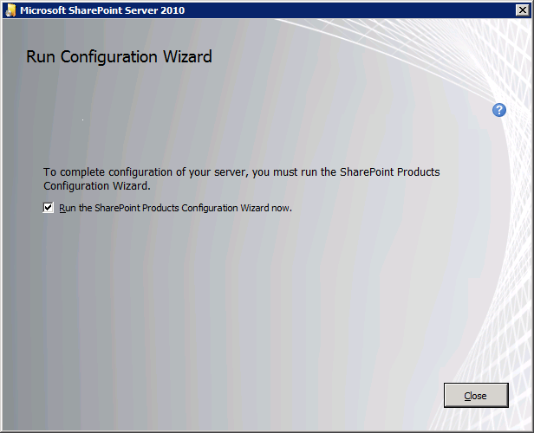
SharePoint Products Configuration Wizard (Part 1)
Run the Configuration Wizard after installation
Informally known as the "Gray Wizard"
Gray Wizard assists you to create a new farm
Farm creation requires new configuration database
Notes:
The Configuration Wizard will walk you through the creation of the different parts that make up the new SharePoint 2010 farm and configuration database.

Slide 34
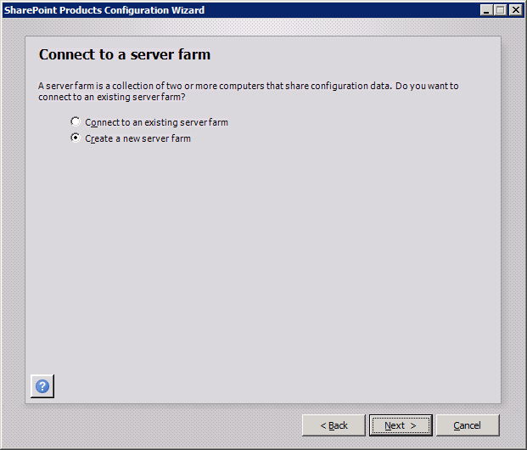
SharePoint Products Configuration Wizard (Part 2)
Select Create a new server farm
This begins process to create configuration database
Only done on first Web server in farm
Other Web servers use Connect to existing farm option
Notes:
When the Configuration Wizard runs on the first server, choose Create a new server farm. This creates the configuration database. When you install and configure SharePoint 2010 on additional web servers, you can choose the Connect to exsiting server farm option.

Slide 35
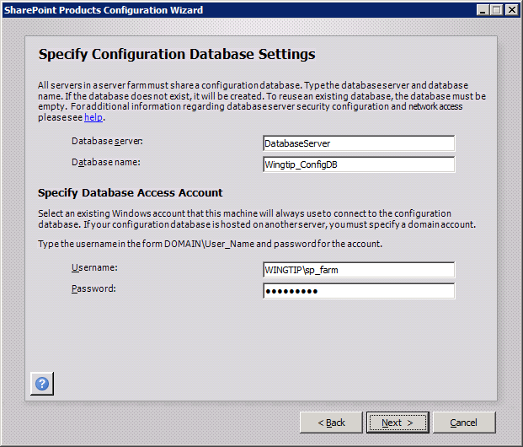
SharePoint Products Configuration Wizard (Part 3)
Specify Configuration Database Settings
Database Server Name
Database Name
User name for farm account
Password
Notes:
You will be asked to specify the database server (on which you installed SQL Server) and a name for the configuration database.
You must also specify the name of the farm account and the password.

Slide 36
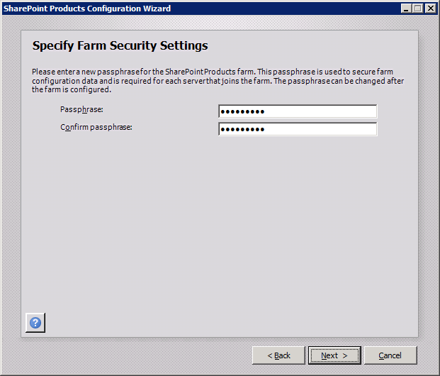
SharePoint Products Configuration Wizard (Part 4)
SharePoint 2010 introduces farm passphrase
Used to control adding more Web servers to farm
Passphrase will be required when adding more Web Servers to farm
Notes:
The farm passphrase is a new feature in SharePoint 2010. It is required when adding or removing a server from the farm.

Slide 37
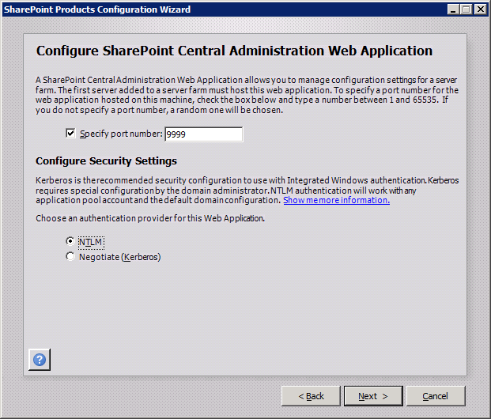
SharePoint Products Configuration Wizard (Part 5)
Specify port number for Central Admin access
Choose between NTLM and Kerberos
Note - this choice only affects Central Administration
Notes:
The next page in the wizard asks you to specify a port number for the SharePoint Central Administration.
Besides that you should also configure security settings. Both NTLM and Kerberos are used with Integrated Windows authentication in Classic Mode.
NTLM credentials are based on data obtained during the interactive logon process and consist of a domain name, a user name, and a one-way hash of the user's password. NTLM uses an encrypted challenge/response protocol to authenticate a user without sending the user's password over the wire. Instead, the system requesting authentication must perform a calculation that proves it has access to the secured NTLM credentials. NTLMrequires re-authentication when accessing a new network resource.
Kerberos, relies on a ticketing system where a client and server access a trusted authority which responds to client requests and grants tickets that the client can use to access network resources. Kerberos does not require re-authentication for accessing multiple resources.

Slide 38
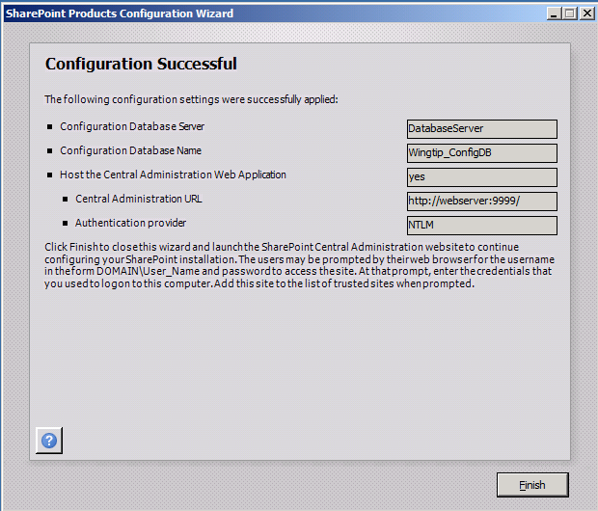
SharePoint Products Configuration Wizard (Part 6)
Success!
Farm and configuration database have been created
You can now access Central Administration
Notes:
When you arrive at this page, the SharePoint 2010 installation and configuration was successful. From here you can access the SharePoint Central Administration.

Slide 39
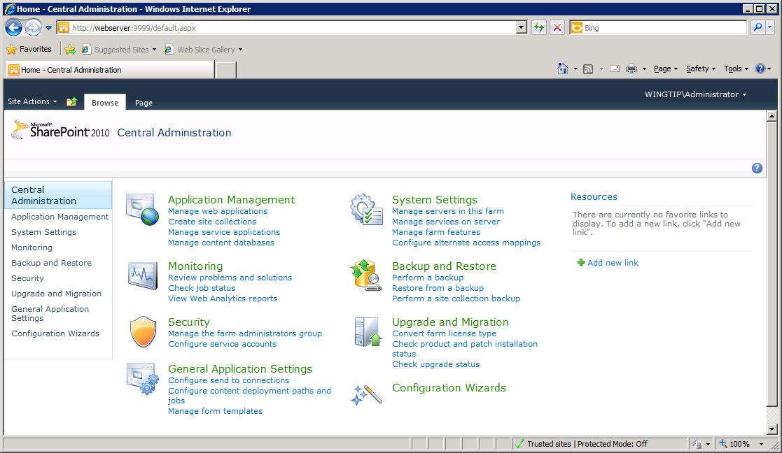
Central Administration
Welcome to your new home
Notes:
This is the new layout of the SharePoint 2010 Central Administration. The home page displays a better overview of the different management tasks. Each hyperlink brings you to a page where you can configure details of your SharePoint farm.

Slide 40
Summary
Understanding Farm Topologies
Installing Perquisite Software
Creating Dedicated Service Accounts
Installing SharePoint Server 2010
Creating the Farm and Configuration Database

